Slide 1
Crystal Field Theory

Slide 2
The valence bond theory could not explain the stability of the coordination compounds. It also failed to throw a light on the differences between strong and weak ligands. Therefore, scientists proposed the crystal field theory.
According to this theory, the metal-ligand bond acts as an ionic bond arising purely from the electrostatic interactions between the metal ions and ligands. This theory takes anions as point charges and neutral molecules as dipoles. When the transition metals do not bond to any ligand, their d orbitals degenerate. This means that they have the same amount of energy.
When they start bonding with other ligands, the d orbitals split apart and become non-degenerate. This bonding occurs mainly due to different symmetries of the d orbitals and the inductive effect of the ligands on the electrons. The pattern of the splitting of d orbitals depends on upon the nature of crystal field.

Slide 3
Salient features of CFT
In a complex central metal atom or ion is surrounded by various ligands.
Ligands are negatively charged ions or neutral molecules, having lone pair of electrons (i.e. H₂O, NH₃).
Metal ion & ligands are considered point charges. Their interaction is purely electrostatics (ionic).

Slide 4
Important features of CFT
When ligands approach to central metal, degeneracy of d-orbitals in metal removed due to repulsion between metal & ligands & split into different energy levels (t2g or eg). The repulsion is more if ligands approach along the axis of d-orbitals & acquire higher energy (eg in oh or t2g in Td). While repulsion is less if ligands approach in between the axis of d-orbitals & acquire less energy (t2g in oh or eg in Td). Thus difference between these splited energy is called crystal field stabilizing energy (CFSE) & denoted by 10 Dq or small delta. 10Dq Value depends on geometry of complexes.

Slide 5
Important features of CFT
Electrons of metal are filled in splited d-orbital. According to Hund's rule i.e. from lower energy levels.
Since there is no orbital overlapping hence no covalent character in bonding.
The magnitude of CFSE depends on nature & number of ligands & also geometry of complex.
If CFSE> 0 then stable complex, if CFSE < 0 then unstable complex.

Slide 6
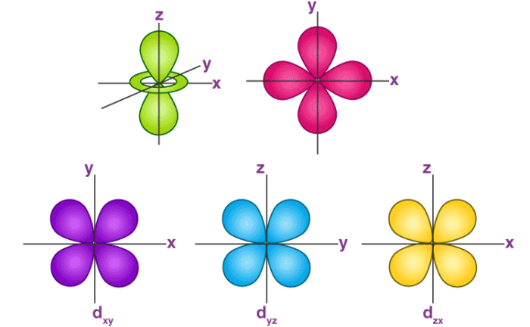
Shape of d-orbitals
e_{g} set
d_{x}²_{-dy}²
d_{z}²
t_{2g} set

Slide 7
Splitting of Crystal Fields
In case of an octahedral coordination compound, there are six ligands that surround the metal atom/ion. In these cases, we observe repulsion between the electrons in d orbitals and ligand electrons. This repulsion is more in the case of d_{x2-y2} and d_{z2} orbitals. This is because they point towards the axes along the direction of ligand. Hence, their energy is higher as compared to the average energy in spherical crystal field.
While, d_{xy}, d_{yz}and d_{xz} orbitals experience lower repulsions as they are directed between the axes. Hence, these three orbitals possess lower energy than the average energy in spherical crystal field. Thus, we get two energy levels:
t_{2g}– set of three orbitals (d_{xy}, d_{yz} and d_{xz}) with lower energy
e_{g} – set of two orbitals (d_{x2-y2} and d_{z2}) with higher energy

Slide 8
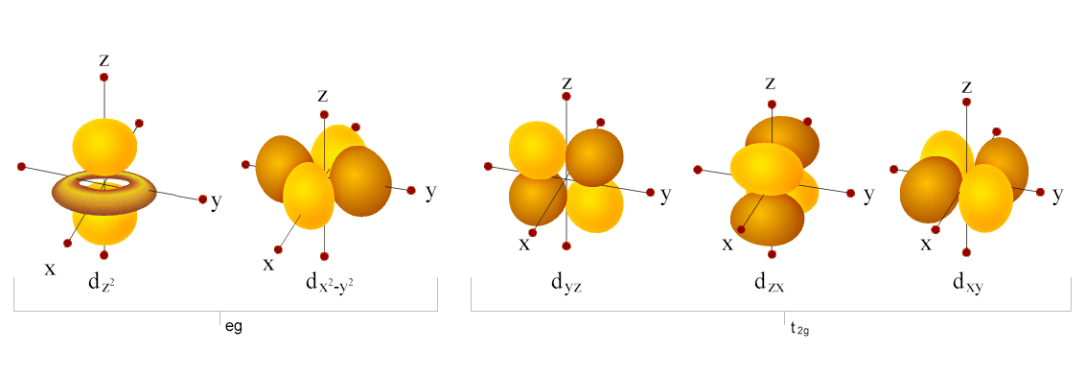
Orbital Splitting:
The five d-orbitals are given the symbols dxy, dzx, dyz, dx²-y² and dz². In a complex they are all differently aligned relative to the incoming charge. Depending on the geometry of the complex, some of the d-orbitals will point directly towards the ligands, while some will point between them. Those which point at the ligands will experience more repulsion between their own electrons and those of the incoming ligands, than will those which do not point directly at them. Thus, the orbitals pointing at the ligands will be less stable and higher in energy. Now all the d-orbitals are no longer equivalent, giving rise to the phenomenon of orbital splitting, and the difference in energy between the more and less repelled orbitals is called the crystal field splitting parameter.

Slide 9
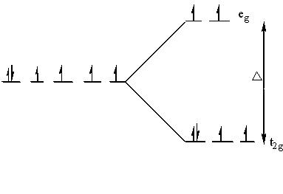
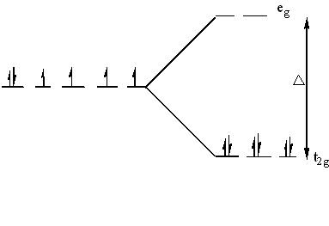
The electrons can go into either a high spin or low spin arrangement depending on the magnitude of the crystal field splitting energy.
High spin
Low spin

Slide 10
The Spectrochemical Series:
The variation of the magnitude of the crystal field splitting (Δ) with the nature of the ligand follows a regular order, known as spectrochemical series. This series is given below in the order in which they produce increasing value of Δ.
I- < Br- < S22-< SCN- <cl- < N3- < F- < urea, OH- < ox, O2- < H2O < NCS- < py, NH3 < en < bipy, phen < NO2- < CH3-, C6H5-< CN- </cl
Weak field ligands have small Δ and will form high spin complexes.
Strong field ligands have large Δ and will form low spin complexes.

Slide 11
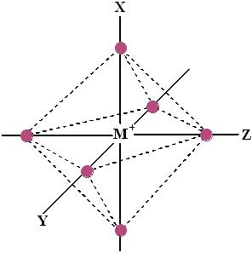
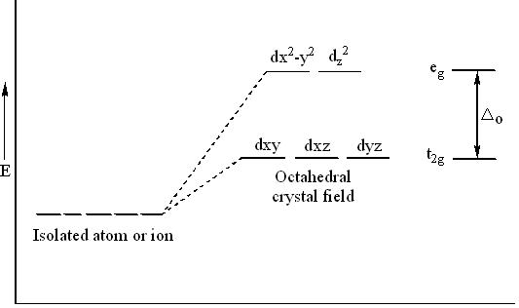
Octahedral Complexes:
The octahedral arrangement of six ligands surrounding the central metal ion is as shown in the figure.

Slide 12
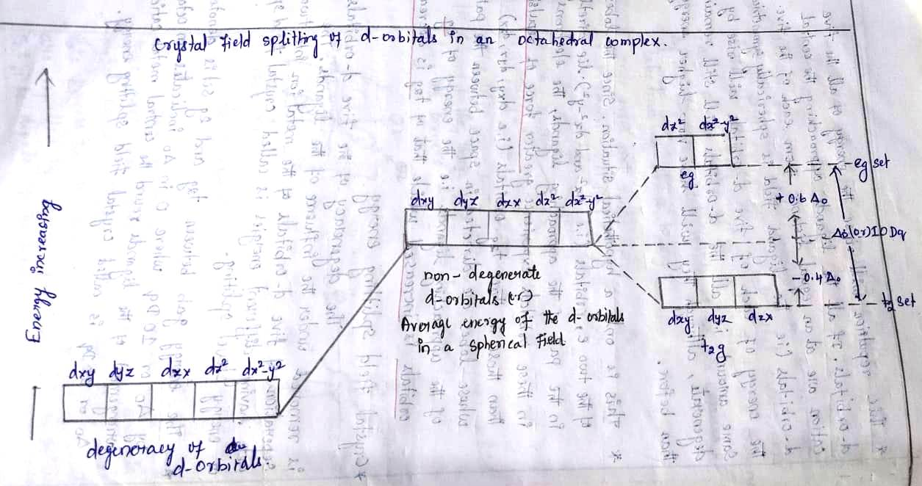

Slide 13
In an octahedral complex, the metal ion is at the centre and the ligands are at the six corners. In the figure, the directions x, y and z point to the three adjacent corners of the octahedran. The lobes of the eg orbitals (dx2-y2 and dz2) point along the x, y and z axis while the lobes of the t2g orbitals (dxy, dzx and dyz)point in between the axes. As a result, the approach of six ligands along the x, y z, -x,-y and –z directions will increase the energy of dx2-y2 and dz2 orbitals (which point towards the ligands) much more than that it increases the energy of dxy, dzx and dyz orbitals ( which point in between the metal-legand bond axis).

Slide 14
Thus, under the influence of an octahedral field, the d orbitals split into triply degenerate orbitals with less energy and another as doubly degenerate orbitals with higher energy. The main energy level between these two sets of orbitals is taken as zero, which is called bari centre. The splitting between these two orbitals is called crystal field splitting. The magnitude of stabilization will be 0.4 Δo and the magnitude of destabilization will be 0.6 Δo.

Slide 15
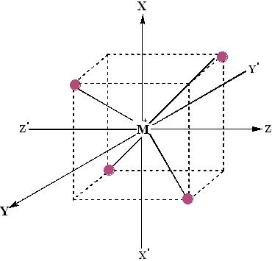
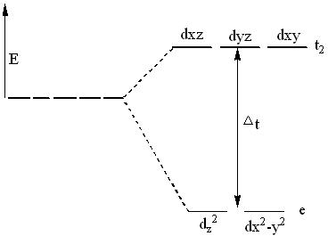
Tetrahedral Complex:
The tetrahedral arrangement of four ligands surrounding the metal ions is as shown in the figure.

Slide 16
A regular tetrahedron is a cube. One atom is at the centre of the cube and four of the eight corners of the cube are occupied by ligands. The directions x, y and z point to the face centres. The dx2-y2 and dz2 orbitals point along the x, y and z directions and dxy, dzx and dyz orbitals point in between x, y and z directions.
The direction of approach of ligands does not coincide exactly with either the e or t2 orbitals. The t2 orbitals are pointing close to the direction in which the e orbitals are lying in between the ligands. As a result, the energy of t2 orbitals increases compared to the energy of e orbitals. Thus, d orbitals again split into two sets- triply degenerate t2 of higher energy and doubly degenerate e orbitals of lower energy. That is, t2 orbitals are raised by 0.4 Δt in energy and the e orbitals are stabilized by 0.6 Δt in energy.
The energy difference between the two sets of orbitals (Δt) will be about half the magnitude of that in an octahedral complex (Δo).

Slide 17
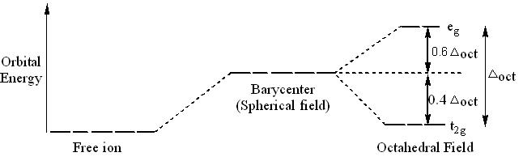
Crystal Field Stabilization Energy:
The crystal field stabilization energy (CFSE) is the stability that results from placing a transition metal ion in the crystal field generated by a set of ligands. It arises due to the fact that when the d-orbitals are split in a ligand field (as described above), some of them become lower in energy than before with respect to a spherical field known as the bari centre in which all five d-orbitals are degenerate. For example, in an octahedral case, the t2g set becomes lower in energy than the orbitals in the bari centre. Owing to the splitting of the d orbitals in a complex, the system gains an extra stability due to the rearrangement of the d electrons filling in the d levels of lower energy. The consequent gain in bonding energy is known as crystal field stabilization energy (CFSE).

Slide 18
Magnetism of transition metal complexes
Compounds with unpaired electrons have an inherent magnetic moment that arises from the electron spin. Such compounds interact strongly with applied magnetic fields.
Their magnetic susceptibility provides a simple way to measure the number of unpaired electrons in a transition metal complex. If a transition metal complex has no unpaired electrons, it is diamagnetic and is weakly repelled from the high field region of an inhomogeneous magnetic field.
Complexes with unpaired electrons are typically paramagnetic. The spins in paramagnets align independently in an applied magnetic field but do not align spontaneously in the absence of a field. Such compounds are attracted to a magnet, i.e., they are drawn into the high field region of an inhomogeneous field. The attractive force, which can be measured with a Guoy balance or a SQUID magnetometer, is proportional to the magnetic susceptibility (χ) of the complex.

Slide 19
The effective magnetic moment of an ion (µ_{eff}), in the absence of spin-orbit coupling, is given by the sum of its spin and orbital moments:
µ_{eff} = µ_{spin} + µ_{orbital} = µ_{s} + µ_{L}
In octahedral 3d metal complexes, the orbital angular momentum is largely "quenched" by symmetry, so we can approximate:
µ_{eff} ≈ µ_{s}
We can calculate µ_{s} from the number of unpaired electrons (n) using:
Here µ_{B} is the Bohr magneton (= eh/4πm_{e}) = 9.3 x 10⁻²⁴ J/T. This spin-only formula is a good approximation for first-row transition metal complexes, especially high spin complexes.

